Slide 1







Enterprise Blockchain Developers (Intermediate)
In support of
Powered By

Slide 2
Outline
Proxy Code Demo
React Node Integration
Webpack
Webserver
© 2017-2020 SmartMesh Foundation Pte. Ltd. | MeshBox Foundation Pte. Ltd.

Slide 3
Code Demo
2 Integrating React to Nodejs

Slide 4
Lanuch a project on production
step 1. host the application
method 1: compile the frontend / backend
usually on production, we could use pm2 or forever, this kind of process protector to host the appliction
method 2: Dockernize / daemonize the backend and frontend
run docker directly
step 2. config webserver /var/www/html
step 3. config DNS

Slide 5
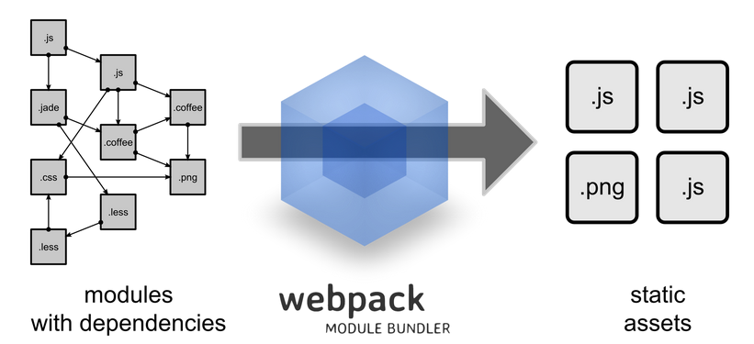
What is Webpacks
The ultimate goal of webpack is to unify all these different sources and module types in a way that's possible to import everything in your JavaScript code, and finally produce a shippable output.

Slide 6
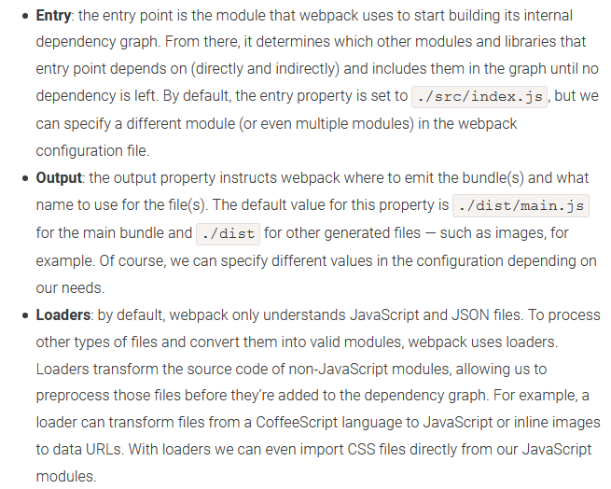
What is Webpacks
The ultimate goal of webpack is to unify all these different sources and module types in a way that's possible to import everything in your JavaScript code, and finally produce a shippable output.

Slide 7
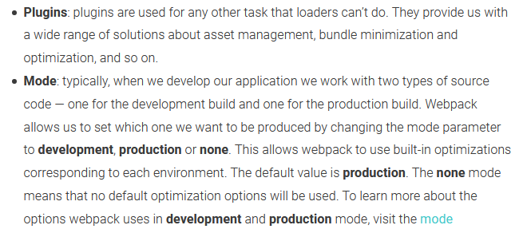
What is Webpacks
The ultimate goal of webpack is to unify all these different sources and module types in a way that's possible to import everything in your JavaScript code, and finally produce a shippable output.

Slide 8
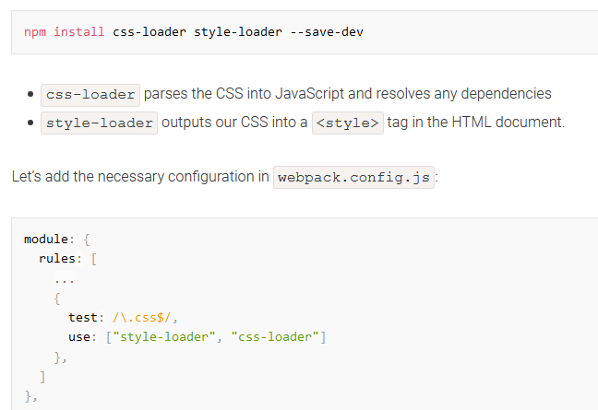
What is Webpacks
Plugin Example

Slide 9
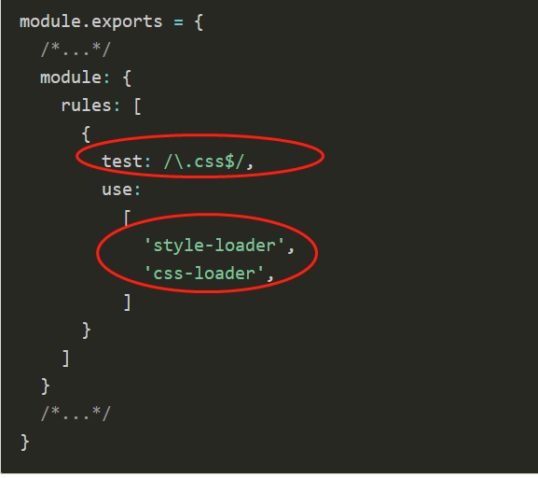
What is Webpacks
Handle CSS
test - regular expressrion, to find satisfied files. use - load plugin

Slide 10
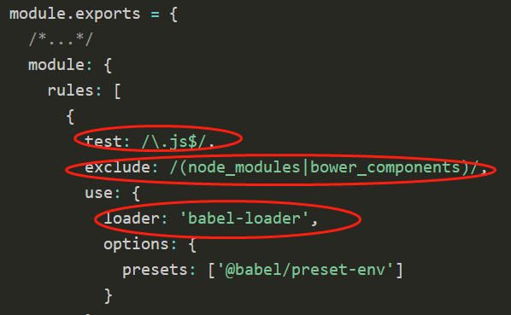
What is Webpacks
Handle JS
test - regular expressrion, to find satisfied files. use - load plugin

Slide 11
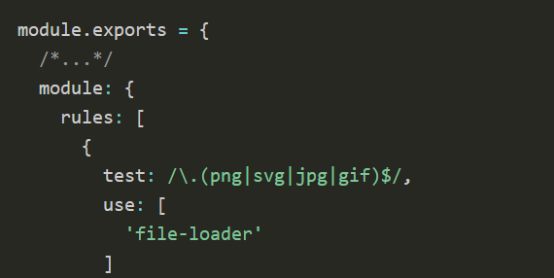
What is Webpacks
Handle JS
test - regular expressrion, to find satisfied files. use - load plugin

Slide 12
Compile the frontend
Webpack vs Pracel vs react build etc
react-scripts hides all of the webpack configs behind the scenes.
Pracel cannot do code splitting

Slide 13
Code Demo
Webpack compile an api application
use pm2 to host the whole application
Dockernize Frontend and backend

Slide 14
Apache
What is Apache and a Web Server?
Apache is a web server software. The web server checks for the web page you have requested and fetches it for your viewing pleasure. However, A web server is not just your host but also your server. Once it has found the web page you requested, it also serves you the web page
© 2017-2020 SmartMesh Foundation Pte. Ltd. | MeshBox Foundation Pte. Ltd.

Slide 15
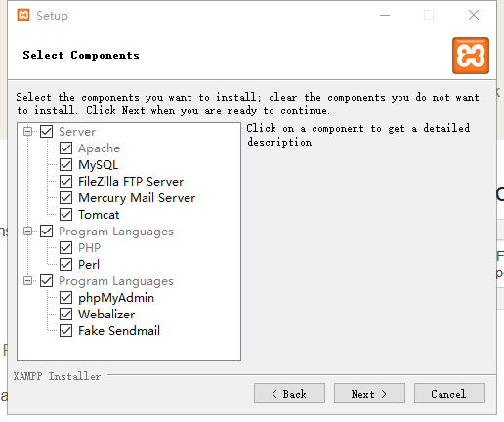
Apache
XAMPP (explain the folder structure)
© 2017-2020 SmartMesh Foundation Pte. Ltd. | MeshBox Foundation Pte. Ltd.

Slide 16
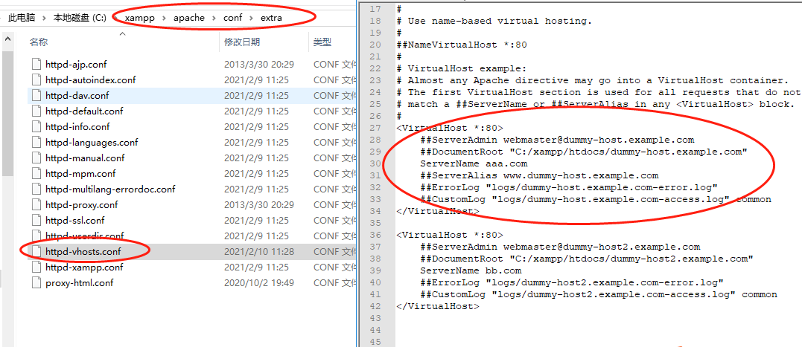
Apache
XAMPP (explain the folder structure)
© 2017-2020 SmartMesh Foundation Pte. Ltd. | MeshBox Foundation Pte. Ltd.

Slide 17
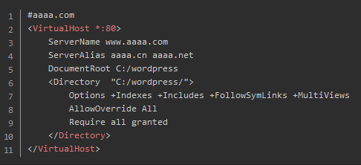
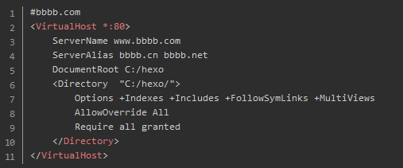
Apache
XAMPP: Host muliple websites
© 2017-2020 SmartMesh Foundation Pte. Ltd. | MeshBox Foundation Pte. Ltd.

Slide 18
Nginx
What is Nginx?
NGINX is open source software for web serving, reverse proxying, caching, load balancing, media streaming, and more.
(code demo: how to set domain for a website)
(explain the folder structure)
© 2017-2020 SmartMesh Foundation Pte. Ltd. | MeshBox Foundation Pte. Ltd.

Slide 19
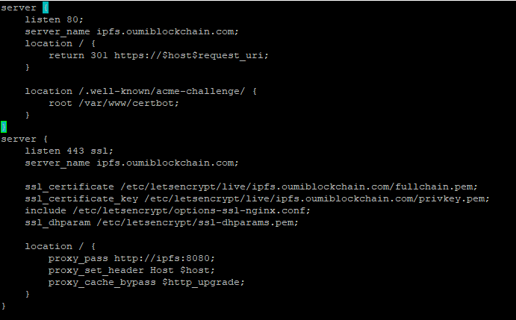
Nginx
What is Nginx?
reverse proxying
© 2017-2020 SmartMesh Foundation Pte. Ltd. | MeshBox Foundation Pte. Ltd.

Slide 20
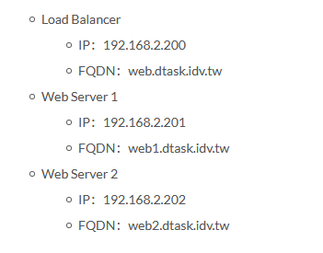
Nginx
What is Nginx?
Load Balancing
© 2017-2020 SmartMesh Foundation Pte. Ltd. | MeshBox Foundation Pte. Ltd.

Slide 21
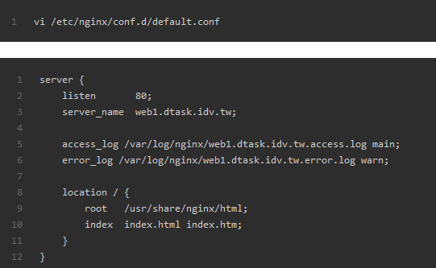
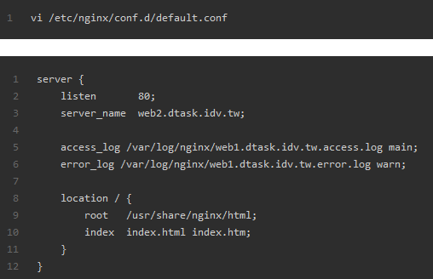
Nginx
Load Balancing
© 2017-2020 SmartMesh Foundation Pte. Ltd. | MeshBox Foundation Pte. Ltd.

Slide 22
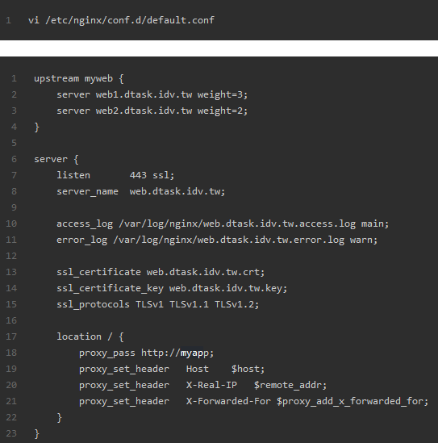
Nginx
Load Balancing
© 2017-2020 SmartMesh Foundation Pte. Ltd. | MeshBox Foundation Pte. Ltd.

